Slide 1
Mini ETL-Project
Tonje, Audun and Maria

Slide 2
Background:
- Look at weather data and bysykkel data (Oslo)
Question:
- From-stations with least/most variance in traffic depending on weather
- Also to-stations if time
Data sources:
- Frost
- Bysykkel Oslo (https://oslobysykkel.no/en/open-data/historical)

Slide 3
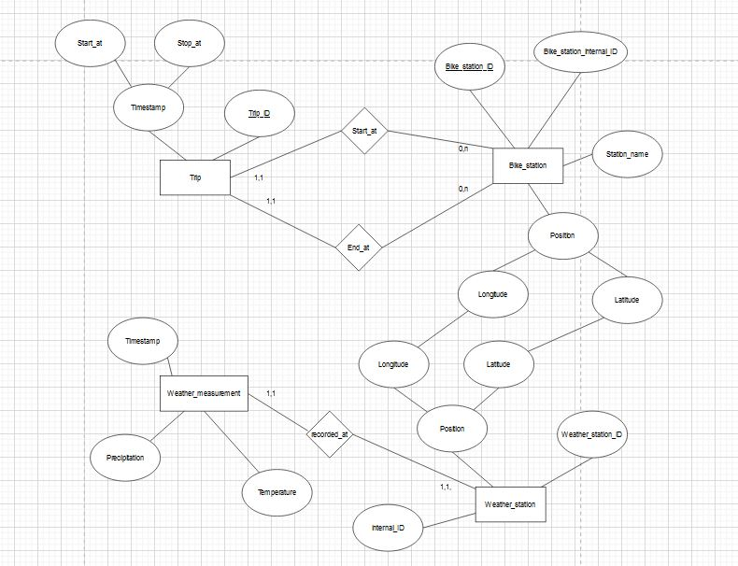

Slide 4
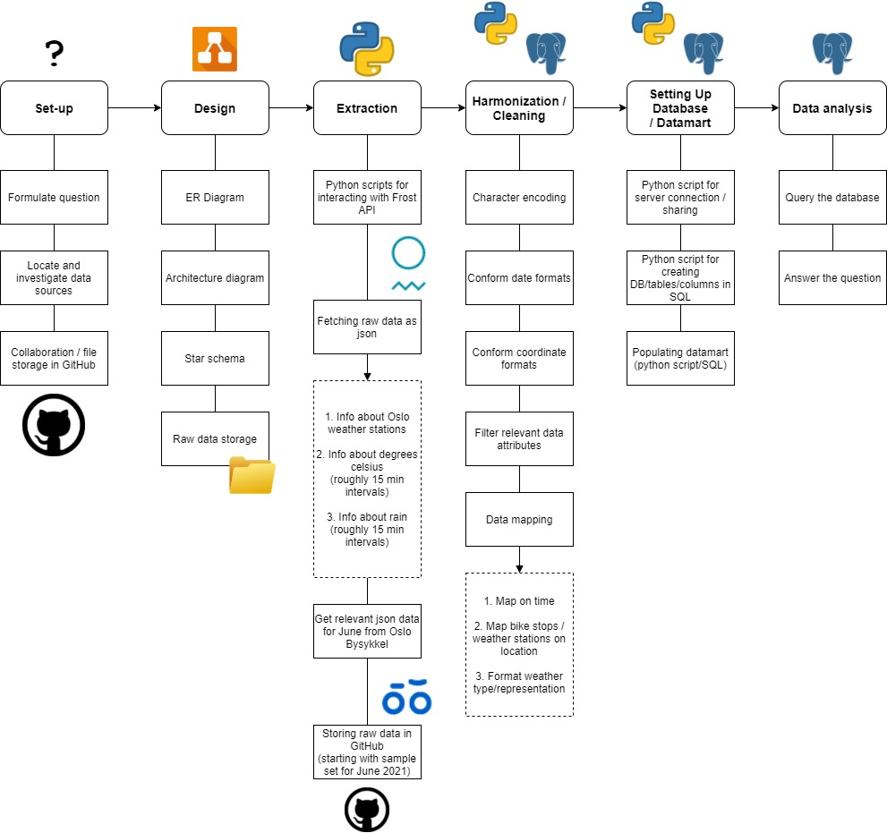
Architecture overview

Slide 5
Challenges
Finding right data in Frost API
Json files
Code for finding columns /data in nested json

Slide 6
If we had more time, we would…
New schema according to data model
Mapped bike stations to weather stations
Analysed our data and answered the question ☺

Slide 7
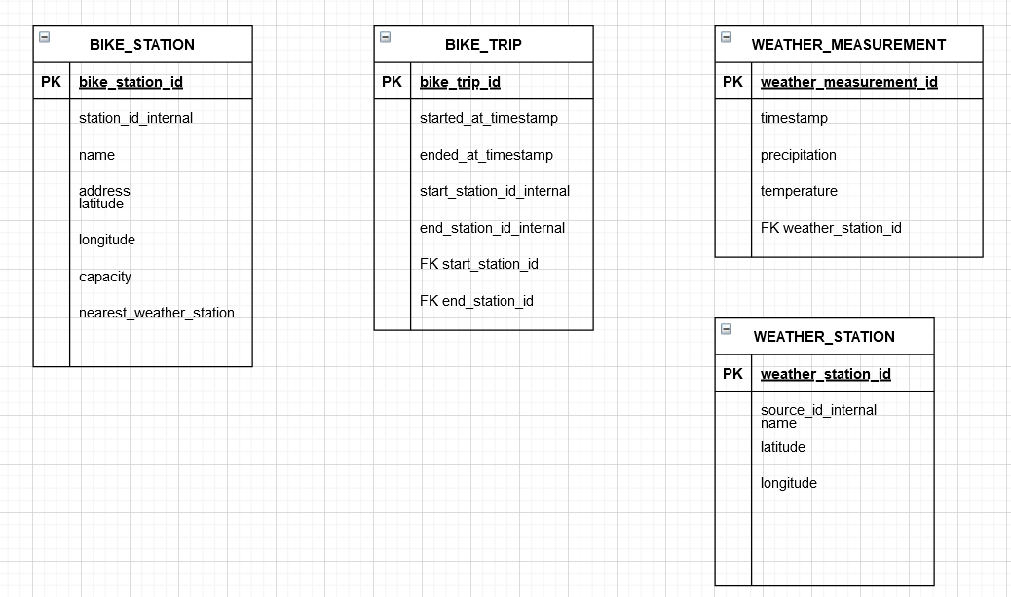
Data model

